Slide 1
Data.ML.450
Time Series Analysis using Machine Learning
1. Introduction
Jari Turunen, TUNI

Slide 2
Time series analysis -course
This course is concentrated on discrete consecutive 1-n dimensional data processing
This course will not deal image-based time series
Students are assumed to have basic+ to moderate coding skills in Python

Slide 3
Passing the course
Course is carried out by making assignments, which reside in Moodle course folders.
URL: http://moodle.tuni.fi
Course assignments are reviewed, and the points are summed. The lowest (sum) point limit is 51, which gives the grade 1, and 91 is the lowest limit for grade 5 in 0-5 grade scale.
There are plenty of assignments in the course folders, there is no need to do all the assignments. You can choose yourself the grade that you are targeting as well as the assignments you want to make

Slide 4
Course grades
This course will be conducted by doing assignments and collecting points:
Sum of points Finnish Scale ETCS scale
0-50 points, grade 0 FX, F (Fail)
51-60 points, grade 1 E (Sufficient)
61-70 points, grade 2 D (Satisfactory)
71-80 points, grade 3 C (Good)
81-90 points, grade 4 B (Very good)
91- points, grade 5 A (Excellent)

Slide 5
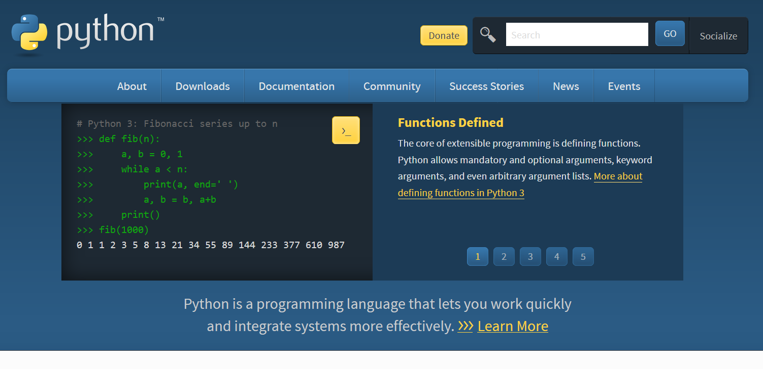

Python
The assignments can be done using various Python / Jupyter notebook etc. Python environments.
Anaconda/Spyder
Pycharm
Python
…
The clips in course slidesets are made using Spyder
Jupyter notebook is handy when doing block-by-block type of exercises (Included in Anaconda package)
https://www.anaconda.com/download/
TUNI, CS faculty is already using Python in many courses (including machine learning courses).

Slide 6
Passing the course
Whatever the simulation environment is:
The basic idea is to minimize the handwork and let the computer do the job
Also the understanding of the basic principles and techniques behind the code(s) are important
The code is necessary ’need’ for understanding the operation in question for the time series
For example if you are using IBM WATSON environment or similar platform from Google or MS (for example in your future work later after graduation), you will recognize and know the blocks by name, for example ”ARIMA” or ”DeepAR”

Slide 7
Passing the course
It is dangerous to use the machine learning mechanisms as a black box model without understanding the phenomena what we are modelling
There are plenty of underlying theory and links and Python examples behind the practical operations in the following slides
The naming convention, such as ’filtering’ and ’prediction’ are introduced with the relevant theory
This theory is also important when preparing the data for machine learning

Slide 8
Idea behind the machine learning
The sole purpose for using the machine learning with the time series is to:
Get rid of tedious repeating manual work
Train the machine learning system is such a way that it can analyze the real world data without any problems
Train and test data should cover most (or all) extremities of the real world data
The decision what the machine learning mechanism does must be acceptable in (almost) all the cases

Slide 9
The Essence of Time series
“Time series are sequences, discrete or continuous, of quantitative data assigned to specific moments in time and studied with respect to their statistics of their distribution in time”
Norbert Wiener 1949, Time Series, M.I.T Press

Slide 10
What time series are?
Time series are measurements, which are related to time and measurements are repeated either regularly or irregularly
Current weather data & sensors: temperature, air pressure, wind, humidity, etc.
Radio(tele)metric measurements: pulsars and other astronomical measurements, lidar, radar, ground penetrating radar etc.
Voice recordings, sound monitoring, EEG, ECG, EMG etc.
Business: trade, stock market evolution, long term evaluation of company/companies by the numbers
Satellite photos, for example, on a weekly basis monitoring the drug crops, land use, enemy action etc.

Slide 11
Time series
Time (s) | Water consumption (l/s)
8100 | 3
11700 | 1
12600 | 1.5
13500 | 4
14400 | 2.1
Time series can also be asynchronous. Continuous (discrete) time line can be constructed from the original (asynchronous) time series (observations or sensor readings)

Slide 12
Zero point problem
What is the ’zero’point (starting moment) in time series?
Astronomer: ~13.7 billion years ago
Water level sensor technician: two weeks ago
It is a matter of time series
Usually it is the place in time where the measurement begins
In some cases when the time series is long, we can define the zero point by ourselves
Point (region start) of interest
Earlier data are minus indices, latter plus indices.

Slide 13
What can be done with time series?
The time series analysis can be used to obtain various types of information:
The amplitude of the fluctuations, time and frequency, as well as their mutual and internal dependencies (classification/correlation)
Extreme events, seasonality, trends (classification)
Connecting the time series to the other real time information: explosions, light phenomena, etc. (correlation)
Dependencies to other time series (correlation)

Slide 14
Necessary operations
Data reduction
Generalization operations (for example averaging)
Data transformation
Data cleaning / Gap filling
(Intelligent) noise filtering
Estimate missing data
Prediction / Classification

Slide 15
Data visualization
One cannot express enough how important it is to visualize the data
Visual review is often important, because it reveals:
Trends
Long-time amplitude changes (magnitude up/down)
Cut-offs (saturation)
Error measurements (outliers)
Same applies with the neural network outcome results
Neural network training problems
Generalization problems
…

Slide 16
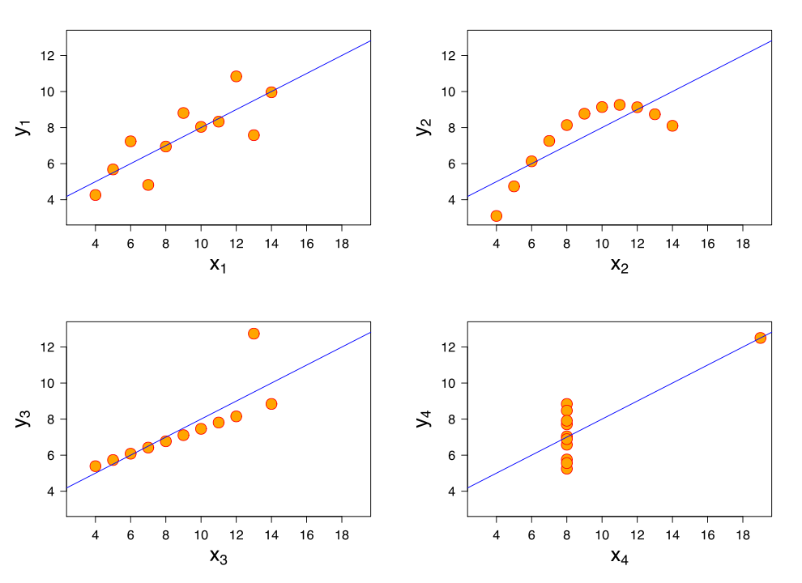
Significance of visualization: Anscombe’s quartet
Anscombe.svg: Schutzderivative work (label using subscripts): Avenue (talk) - Anscombe.svg, CC BY-SA 3.0, https://commons.wikimedia.org/w/index.php?curid=9838454
Anscombe’s quartet indicates clearly the need of visualization before modeling, all the images share same statistical properties

Slide 17
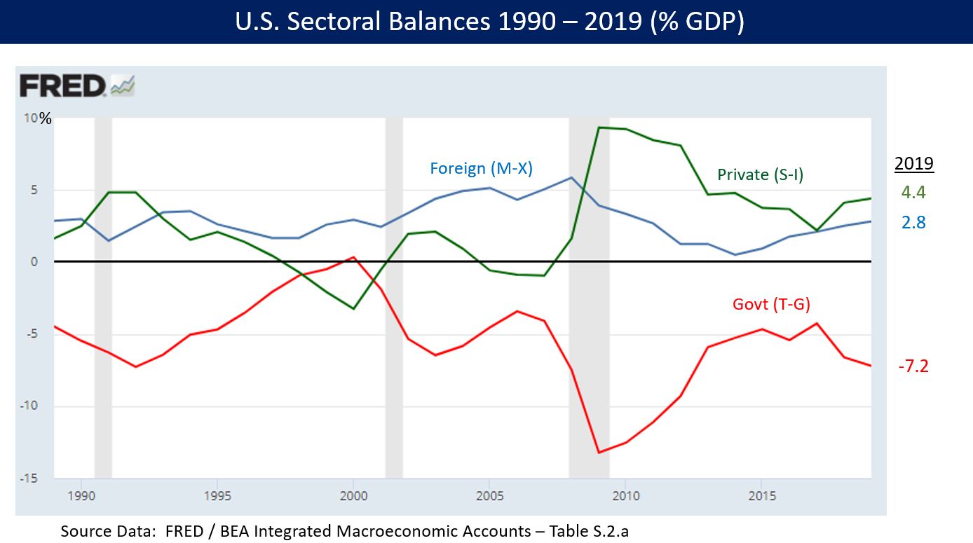
Basics, Amplitude
Amplitude is the value of a single sample (~height, positive or negative) compared to the reference level/plane (usually some constant, in practice zero level)
All peak, middle and valley points are amplitudes in every curve
Wikimedia commons

Slide 18
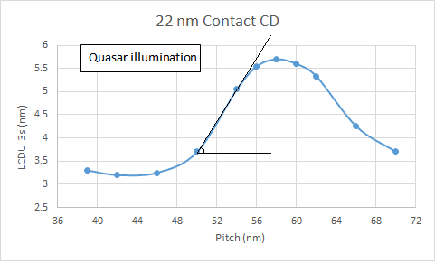
Phase
Phase is the slope (angle) between two consecutive (fixed time) samples
HOWEVER, this phase is not important nor significantly useful, exept when repairing/ interpolating the data
Frequency phases are more useful than this phase
Phase angle
Modified from: By Guiding light - Excel, CC BY-SA 4.0,
https://en.wikipedia.org/w/index.php?curid=56566819

Slide 19
Frequency
Frequency is (lowest frequency in this case) the distance between the two largest peak associated with the periodic recurrence (see the blue curve), or the periodic variation in the measurements of the day
Frequency =
Oscillations / second = Hertz
In this case:
1 oscillation / day =
1 / 24*60*60 Hz =
1 / 86400 Hz
NOTICE: change in
sensor sampling near index 1900
Frequency

Slide 20
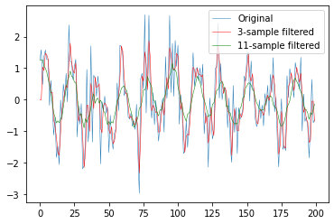
Trends+seasonality
window_experiments.py
import numpy as np
from numpy import cos, sin, pi, absolute, arange, mean
import matplotlib.pyplot as plt
from scipy.stats import skew,kurtosis
fs=8000 #sampling frequency Hz
freq=440 #Hertz
end_time = 0.1
time = np.arange(0,end_time,1/fs) # start, stop, step #time series vector
print(len(time))
y=sin(2*pi*freq*time)+np.random.normal(loc=0.0, scale=0.8, size=[1, len(time)]) #sine curve + added gaussian noise
y=y.squeeze() #remove unnecessary dimensions
print(y.shape)
len1=1 #length of the average filter (trend) (1+2*len)=window size
len2=5 #longer trend (1+2*len2)
x=y*0 #fast initialization
x2=y*0 #x3=x2 #x4=x2
for i in range(len(y)):
print("%d / %d\n" % (i,len(y)))
start=i-len1
if start< 0 : #for initializing the window
start=0
start2=i-len2
if start2<0: #for initializing the window2
start2=0
ending=i+len1
if ending>len(y): #taking care of the
ending=len(y) #end of the window
ending2=i+len2
if ending2>len(y): #taking care of the
ending2=len(y) #end of the window2
if len(y[start:ending])<2:
x[i]=0
else:
x[i]=np.mean(y[start:ending]) #sliding window mean
if len(y[start2:ending2])<2:
x2[i]=0
else:
x2[i]=np.mean(y[start2:ending2]) #sliding window mean
plt.plot(y[:200],linewidth=0.5)
plt.plot(x[:200],'r',linewidth=0.5)
plt.plot(x2[:200],'g',linewidth=0.5) #plot the results
plt.legend(['Original','3-sample filtered','11-sample filtered'])
plt.show()
The trend can be determined by using the average:
Average of time series-> sliding window average (past + future values from this point)
Sliding window: see slides below

Slide 21
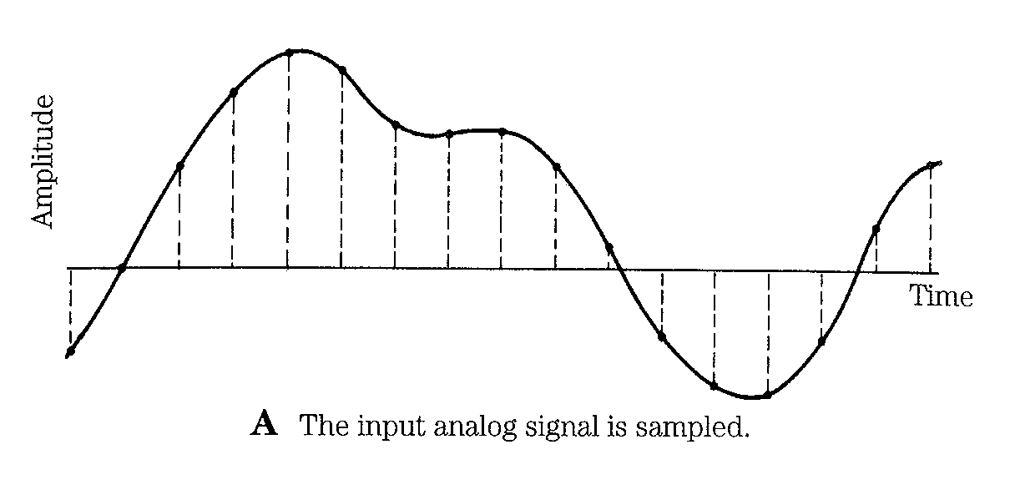
Sampling
Thomas Parsons: Voice and Speech processing, 1987
Continuous data curve samples are taken at regular intervals
What defines the amount of time between sampling?
In temperature measurements?
In music?
Additionally: Uniform or irregular sampling?

Slide 22
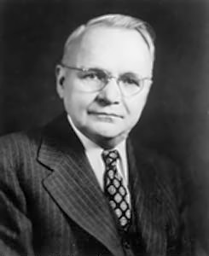
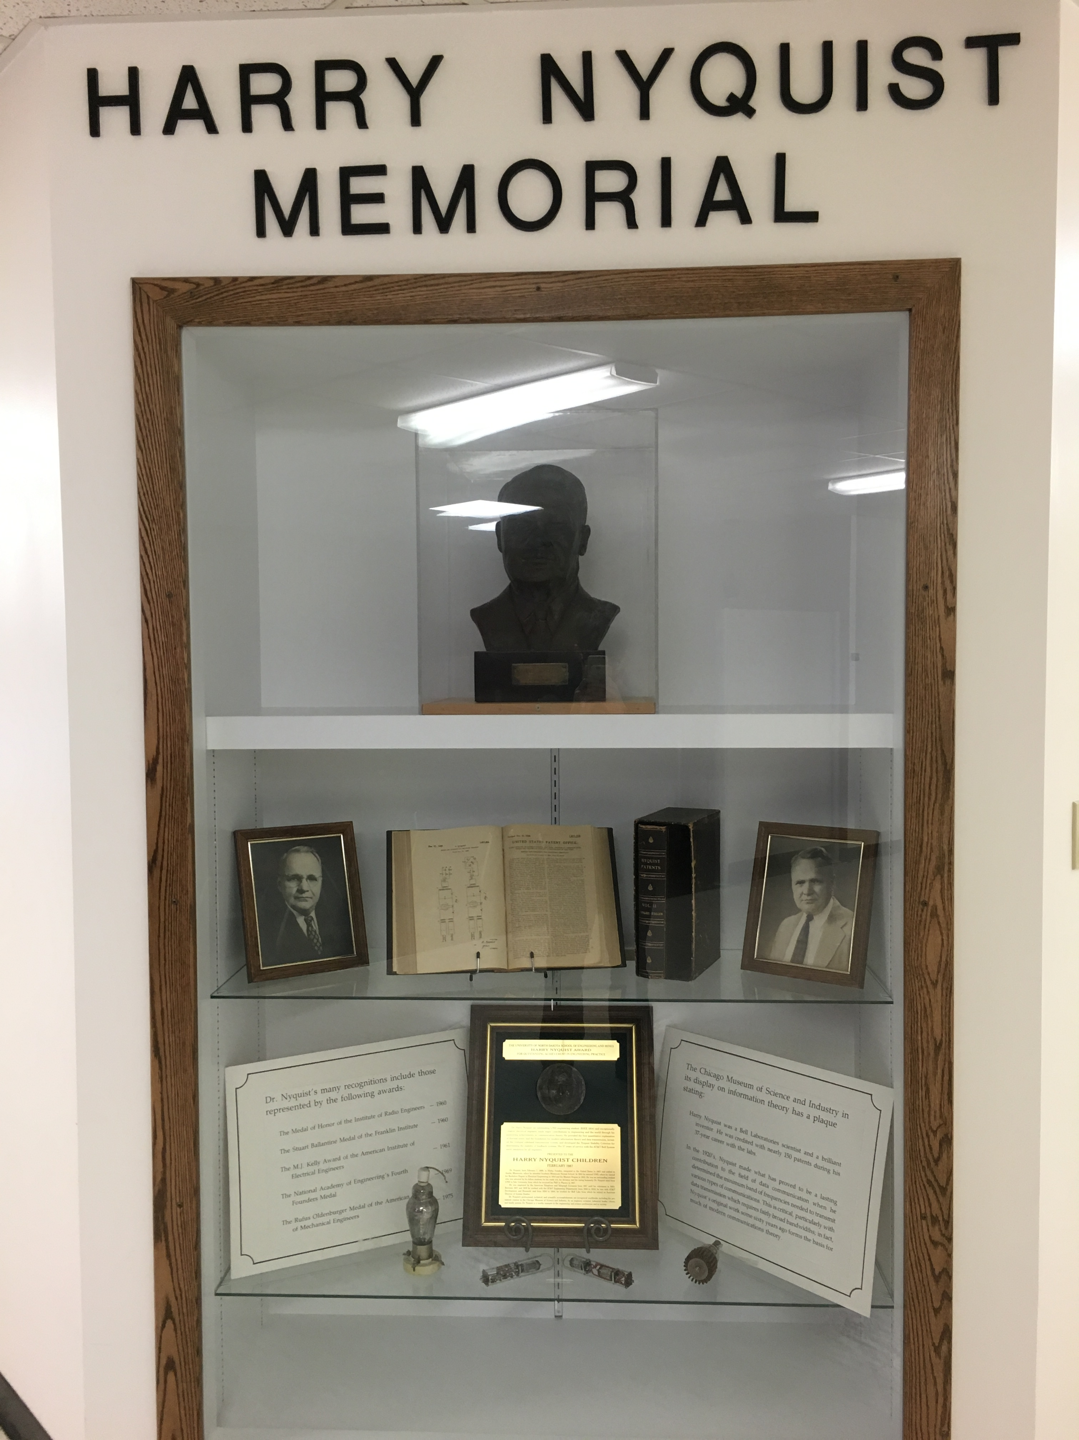
Harry Nyquist 1889-1976
Harry Nyquist is well known by his work in sampling theory
Certain factors affecting telegraph speed, Bell System Technical Journal, 3, 324–346, 1924
Certain topics in Telegraph Transmission Theory, Trans. AIEE, vol. 47, pp. 617–644, Apr. 1928
Nyquist determined that the maximum number of pulses, which went through the telegraph cable (channels) is limited to twice the bandwidth (frequency) of the channel
He defined a bandwidth-pulse theory mathematically, nowadays known as the Nyquist – Shannon sampling theorem
Wikipedia
Creative Commons Attribution-Share
Alike 4.0 International license

Slide 23
Music
DVD-audio
 | 16-, 20- or 24-bits per sample
 | 44.1 kHz | 48 kHz | 88.2 kHz | 96 kHz | 176.4 kHz | 192 kHz
Mono (1.0) | Yes | Yes | Yes | Yes | Yes | Yes
Stereo (2.0) | Yes | Yes | Yes | Yes | Yes | Yes
Stereo (2.1) | Yes | Yes | Yes | Yes | No | No
Stereo + mono surround (3.0 or 3.1) | Yes | Yes | Yes | Yes | No | No
Quad (4.0 or 4.1) | Yes | Yes | Yes | Yes | No | No
3-stereo (3.0 or 3.1) | Yes | Yes | Yes | Yes | No | No
3-stereo + mono surround (4.0 or 4.1) | Yes | Yes | Yes | Yes | No | No
Full surround (5.0 or 5.1) | Yes | Yes | Yes | Yes | No | No
Humans can hear about 20 kHz = 20000 Hz
Adding ~2 kHz for extra tolerance
A well known sampling frequency is 44100 Hz
However, 88200 Hz – is now used for sampling frequencies, 196400 Hz or even more are available in certain musical devices
Is an oversampling harmful or, rather, is it useful (see table)?
Humans cannot hear over 20 kHz after all?
Wikipedia

Slide 24
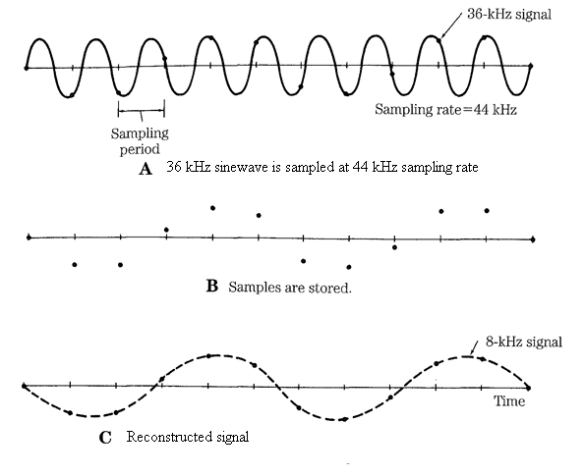
Undersampling
What happens if the desired signal is sampled using lower sampling frequency?
Note: These pictures contain small error that can confuse thinking. 36 kHz sine is originally sampled at minimum of 72 kHz frequency.
Now it is sampled again using 44 kHz frequency. As you know from previous, using 44 kHz sampling rate, it is possible to restore maximum of 22 kHz, and therefore it is impossible to restore the 36 kHz from 44 kHz sampling frequency.
36 kHz signal will have cut-off for 'the difference between the new sampling and the old desired frequencies‘ and the result is the remaining 8 kHz sinusoidal signal
Thomas Parsons: Voice and Speech processing, 1987

Slide 25
Machine learning
Wikipedia
Machine learning (ML) is a field of study in artificial intelligence concerned with the development and study of statistical algorithms that can learn from data and generalize to unseen data, and thus perform tasks without explicit instructions. Recently, artificial neural networks have been able to surpass many previous approaches in performance.

Slide 26
Machine learning
In this course we are comparing and studying the machine learning with some of the traditional methods
We are experimenting with different parameters and combinations to find best possible solution for the problems that can be found in the industry or research
We are using and testing various datasets to perform machine learning tasks

Slide 27
Machine learning
Typical examples for machine learning are:
Regression i.e. prediction, patching of missing time series data based on one or n parallel time series
Modeling, for understanding the complex behaviour of the complicated machinery in industry
Classification (recognition)
(Pre)processing of data
Cleaning, detrending, sampling rate change…

Slide 28
Why machine learning?
For simple (stationary) data there is no need to use ML
Temperature: heater/cooler can be triggered on/off by simple threshold values
If the dataset contains nonstationarities, trending, heteroskedasticity etc. Then it might be worth looking at ML methods for analyzing the data

Slide 29
Data processing
Time series data can be prosessed
Sample-by-sample basis
Taking sequences from the data (also called windowing)
Statistical measurements usually need more than one sample
It is possible to compute mean from one sample, but what is the point?

Slide 30
Time series analysis using machine learning => windowing
Windowing = take chunks of data and feed it to machine learning system
How the windowing should be done?
If the window length is, say, 10:
we can take the windows by taking samples consecutively between the indices 0-9, 10-19, 20-29 and so on
+ fast to compute
- if window length is large, we may lose the transitional points
’Sliding window’ is taking/analyzing consecutive windows, by indices like 0-9,1-10,2-11 and so on, moving only one sample at a time
+ We can detect the transitional points in time series accurately
- slow to compute
…and all variations between those two extremes
Window length minimum of 1-2 up to some thousands

Slide 31
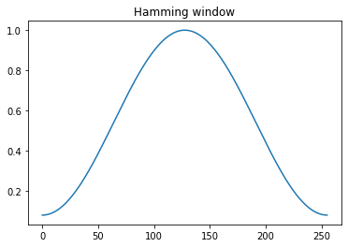
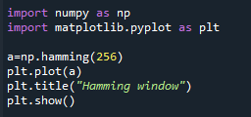
Window types
When taking a frame or window of data it is possible to weight it for different purposes
Uniform, rectangular window (previous slides) every sample is multiplied by one (most commonly used) and the windows are consecutive, non-overlapping
For example, Hamming will weight the edges less than the center
Useful when using overlapping windows procedure
The edges from two overlapped consecutive frames
are summed in final outcome
There are several window types available
However: generally they are not needed
with machine learning, uniform windowing
is enough

Slide 32
Machine learning
Neural networks has become dominant mechanism for regression and classification etc. problems
Increasing the size and make more complicated architecture
-> deep networks
Increasing the size and architecture even more -> AI
Other machine learning mechanisms are, for example:
Clustering/classification/regression
Classification trees
Self organizing maps
K-means clustering
Embedded complex computational systems, for example ARIMA
Etc…

Slide 33
Neural networks
Here are the basics of the most common architechture of machine learning, let as look the other mechanisms later
feedforward neural network

Slide 34

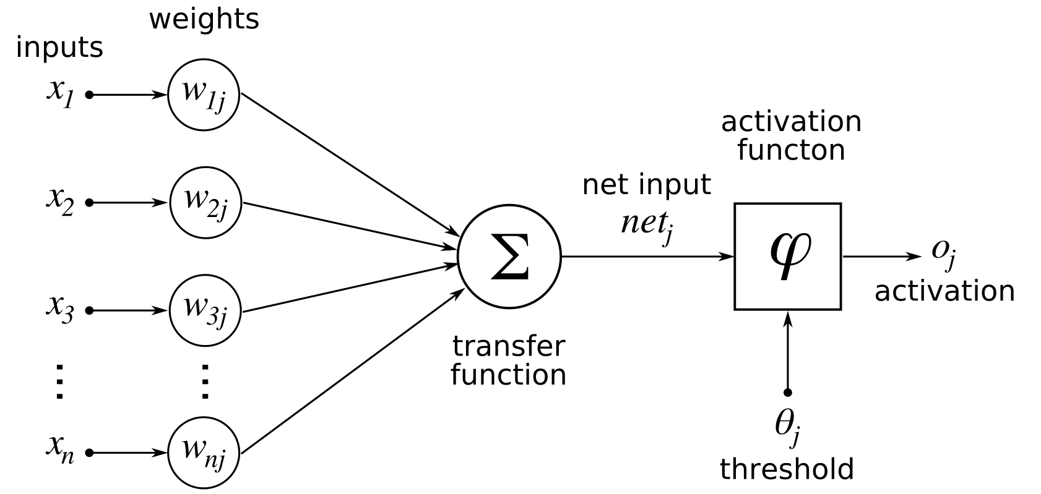
Neural networks
Human nerve cell
Rosenblatt’s perceptron (1957)
https://news.cornell.edu/stories/2019/09/professors-perceptron-paved-way-ai-60-years-too-soon
http://upload.wikimedia.org/wikipedia/commons/1/10/Blausen_0657_MultipolarNeuron.png

Slide 35
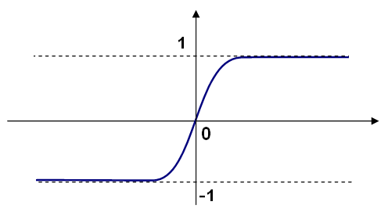

Perceptron / neuron
Perceptron or neuron is simplified reconstruction of neural cell
Multiply inputs with weights, sum all together and carry the result through nonlinear activation function, such as ’sigmoid’.
When using multiple perceptrons stacked in layers the output may grow to
gigantic scale. This is why the every neuron output is limited in each phase of the net.
OpenCV library: ’bipolar sigmoid’
Each circle is a perceptron in this simple neural network.

Slide 36
Network architectures
There exist unlimited number of different network architectures restricted only by imagination
Several hidden layers
Autoencoders (hourglass shaped architecture)
Etc.
Let us look at some of them

Slide 37
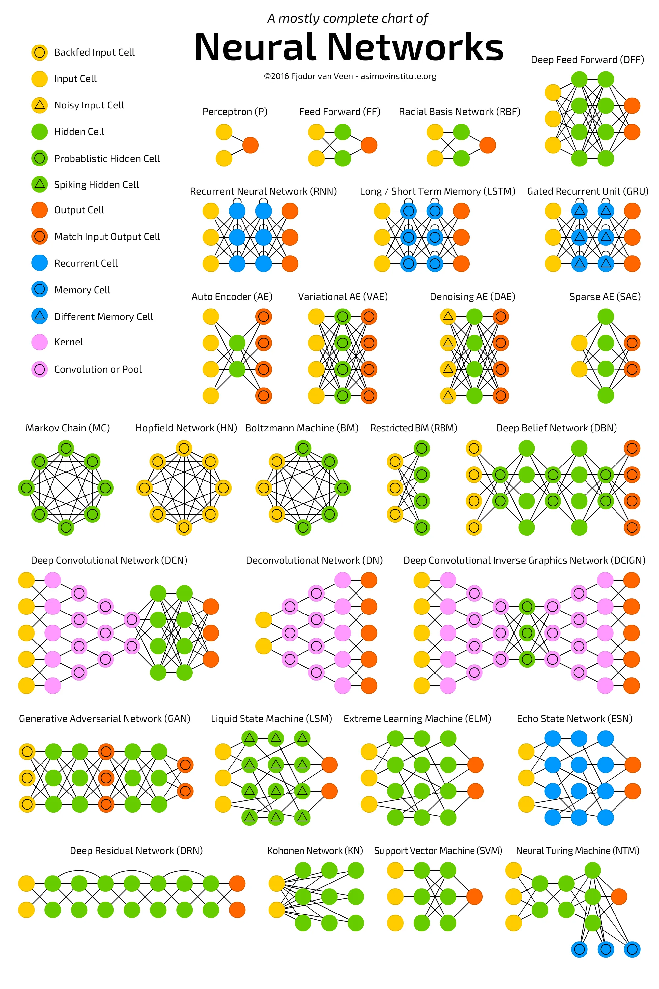
Architectures
https://towardsdatascience.com/the-mostly-complete-chart-of-neural-networks-explained-3fb6f2367464

Slide 38
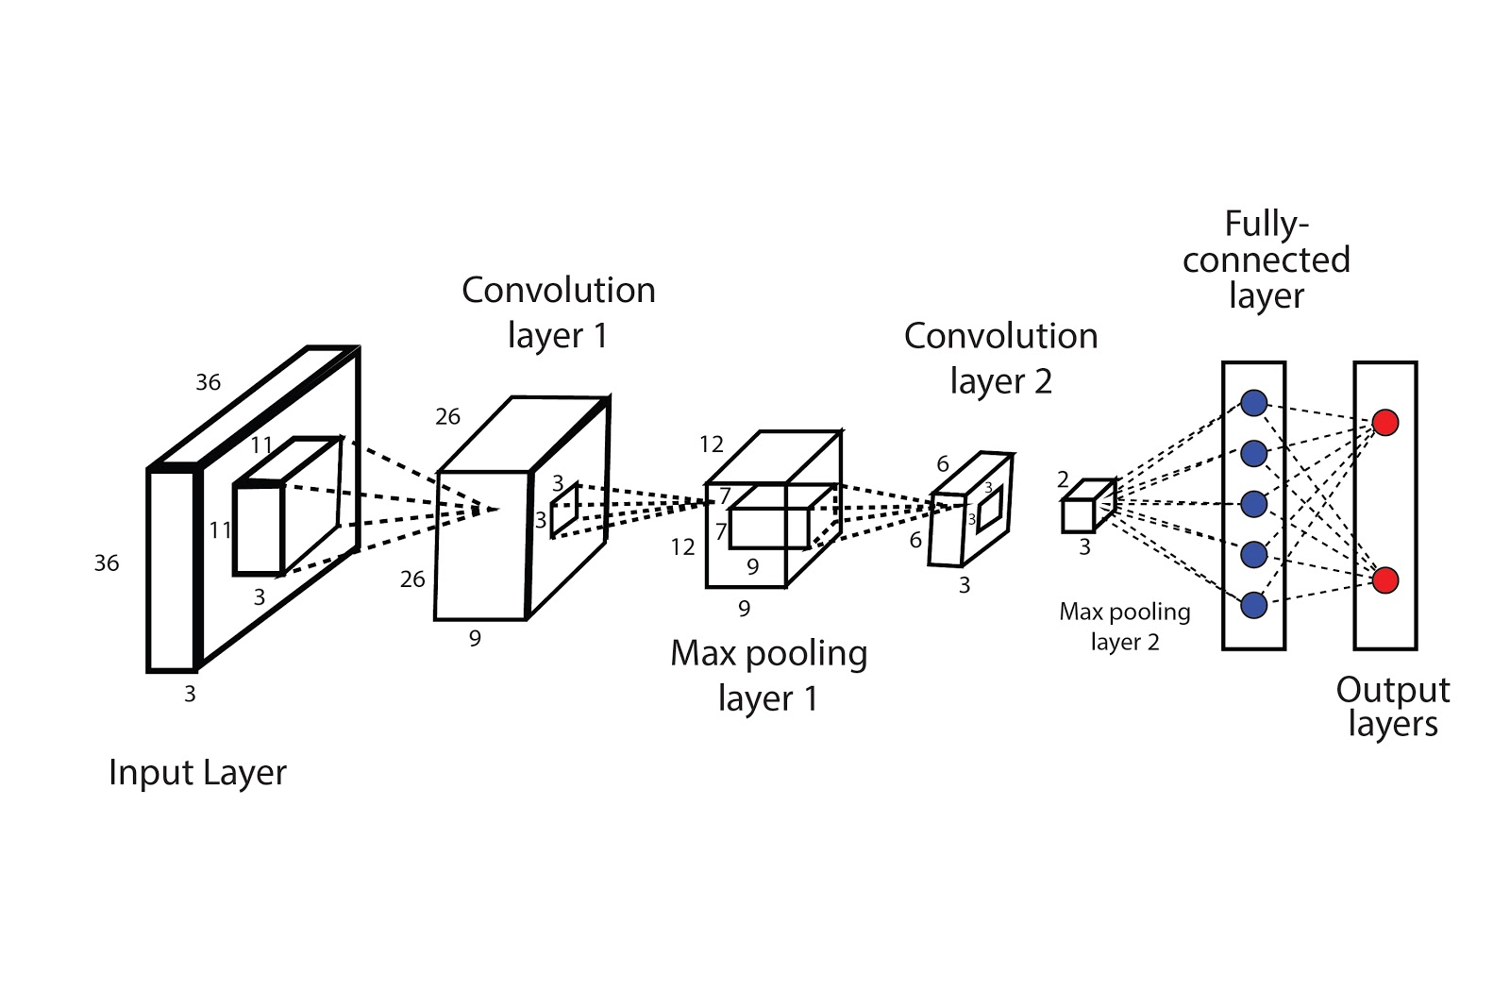
Some architectures
https://www.analyticssteps.com/blogs/common-architectures-convolution-neural-networks
Convolutional neural network (image input 36x36x3)

Slide 39
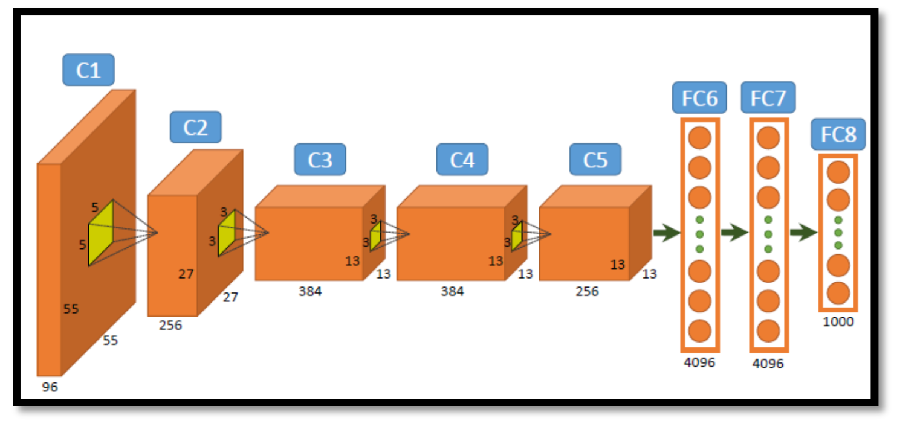
AlexNet (deep learning)
https://www.mdpi.com/2078-2489/11/5/275

Slide 40
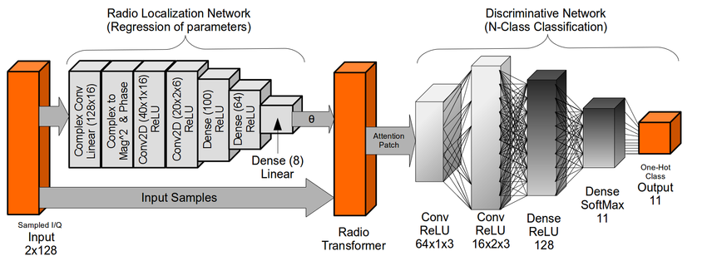
Joined transformer network example
https://www.researchgate.net/figure/Radio-Transformer-Network-Architecture_fig4_301819565

Slide 41
Network learning/training
There are three main categories for network training
Unsupervised learning
Reinforcement learning
Supervised learning
And their variations (semi-supervised etc.)

Slide 42
Unsupervised learning
Network tries to classify the data (withoput any guidance) into separate groups by finding maximal distance between the groups
Learning vector quantization
Self organizing maps
…
Usually for clustering and classification
Let us look unsupervised learning more closely in classification section

Slide 43
Reinforcement learning
Wikipedia
the focus is on finding a balance between exploration (of uncharted territory) and exploitation (of current knowledge) with the goal of maximizing the long-term reward, whose feedback might be incomplete or delayed.
Reward: when the supervisor (human or high-level agent) does not have to interfere the learning process
NOTE: we are not using reinforcement learning in this course

Slide 44
Supervised learning
Input/output pairs of data are introduced to the NN and it tries to find optimal weights and biases to satisfy the input/output dependence between them.
Data (input-output pairs) are introduced several times to the network (dataset introduced to the network one time = 1 epoch). Usually network is trained using 5 ~ 300 (or more) epochs depending on the network size and data size.
Probably most common way to train the networks

Slide 45
Supervised learning
Input(s) are fed to the neuron(s) (weights and biases are initialized with small random value) and the output is computed
True output is compared to network output i.e. e=y - ŷ
Error e is fed back to upstream and small parts of error is shared and divided to the parameters:
Activation threshold: threshold = threshold + (learning rate*internal bias weight*error)
Weights w_{ij}: w_{ij} + (learning rate*internal “weight” weight*error)
Internal weights is the generic division how much error is shared between bias and the input weights and network layers
This procedure is going backwards through the whole network
Error is shrinking when going to upstream in every layer
Notice: “Vanishing gradient problem” with large (deep) networks
Several approaches exist to overcome this problem

Slide 46
Supervised learning
Large datasets are introduced to the networks, not one row at a time, but in series of mini-batches, say 5-200 rows at a time
The training error computation of 5-200 rows are done internally as matrix operation and the parameters are updated based on this error vector
Usually improves the speed of learning process

Slide 47
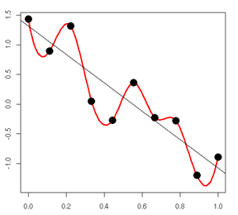
Overtraining / Overfitting
In case of complex topology and lots of epochs are used in training, it could happen that the network will be overtrained and loses its ability to generalize unknown data
Works only with the train data, but fails with unknown and test data
Network will learn the pointwise information too strictly and models the points instead of generalized ’line / surface’ averaged through the points
The output estimate (red curve)
is clearly overfitted. The best generalization is the straight line what we should obtain after the training of machine learning mechanism

Slide 48
Generalization
Generalization (Wikipedia: Machine learning)
The difference between optimization and machine learning arises from the goal of generalization: while optimization algorithms can minimize the loss on a training set, machine learning is concerned with minimizing the loss on unseen samples. Characterizing the generalization of various learning algorithms is an active topic of current research, especially for deep learning algorithms.

